Slide 1
Foundation 1: Cimi Reference Model

Slide 2
CIMI Reference Model - Core
Notes:
Exact Data

Slide 3
Foundation 2: Archetype Object model

Slide 4
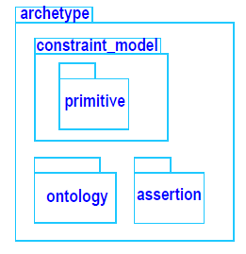
Archetype Object Model (AOM) 1.5

Slide 5
Foundation 3: CIMI Modelling patterns

Slide 6
CIMI Modelling Layers
CLUSTER
ENTRY
SECTION
COMPOSITION
Implementation Purpose Context
Laboratory Test Result Item API
Laboratory Test Observation GUI
Current Medication List in EHR
Laboratory Report Message
Care Setting Context
Inpatient Laboratory Test Result Item
Outpatient Laboratory Test Observation
Outpatient Clinic Current Medication List
Inpatient Laboratory Results Report
Use Case Context
Full Blood Count Test Result Item
Gas and Carbon Monoxide Panel Observation
Current Medication List
Full Blood Count Results Report
Specialty Context
Biochemistry Test Result Item
Microbiology Test Observation
Cardiology Medication List
Biochemistry Laboratory Results Report
Clinical Models
Laboratory Test Result Item,
Refernce Range
Laboratory Test Observation
Medication List
Laboratory Results Report
Patterns
Observable, Finding, Action, Material Entity
Observation,
Clinical Activity
Request
Clinical List
Clinical Report
Reference Model

Slide 7
COMPOSITION modelling patterns
COMPOSITION
constrains
Clinical Report

Slide 8
CIMI-COMPOSITION.clinical_report
constrains

Slide 9
ENTRY modelling patterns
ENTRY
constrains
Clinical Entry
constrains
constrains
constrains
Clinical Report Header
Clinical Activity
Observation
constrains
Request
constrains
Observation Request

Slide 10
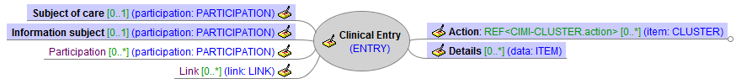
CIMI-ENTRY.clinical_entry
constrains

Slide 11
Foundation 4: Style guides

Slide 12
Archetype Map for
Laboratory Results Report
Composition:
Laboratory Results Report
Laboratory Report Header
Laboratory Test Observation
Entry:
Patient Encounter Summary
Laboratory Test Request Summary
Cluster:
Laboratory Test Observable
Laboratory Test Result Group
Action
Laboratory Test Request
Specimen
Laboratory Test Observable
Reference Range
Action
Action
Action

Slide 13
Laboratory model specialisations

Slide 14
Laboratory Model Specialisations
Complete Blood Count with Manual Differential Panel
Complete Blood Count with Auto Differential Panel
Complete Blood Count without Differential
Gas and Carbon Monoxide Panel

Slide 15
Complete Blood Count Specialisations
ENTRY
constrains
Clinical Entry
constrains
Observation
constrains
Laboratory Test Observation
constrains
Complete Blood Count
constrains
constrains
constrains
Complete Blood Count Without Differential
Complete Blood Count With Auto Differential
Complete Blood Count With Manual Differential

Slide 16
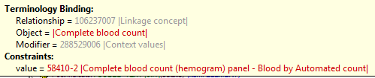
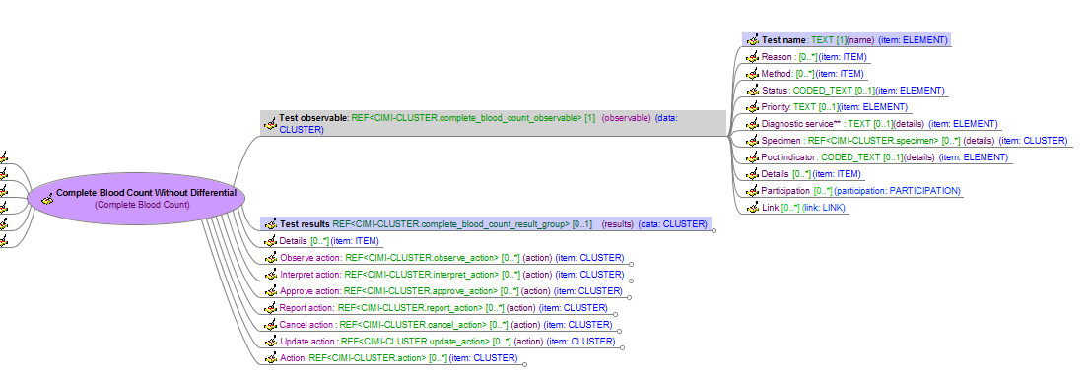
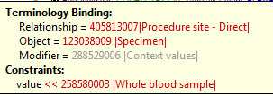

Complete Blood Count Without Differential

Slide 17
Demographics models

Slide 18
Participation & Party Reference Model

Slide 19
CIMI Demographics Models
CLUSTER
Location
Address
Electronic Contact
Party Name
PARTY
ACTOR
Person
Organisation
ROLE
Person Role
Healthcare Consumer
Healthcare Provider
Healthcare Provider Individual
Healthcare Provider Organisation

Slide 20
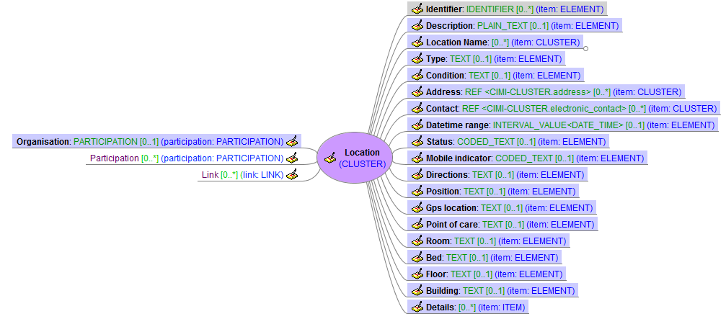
Location
CLUSTER
constrains

Slide 21
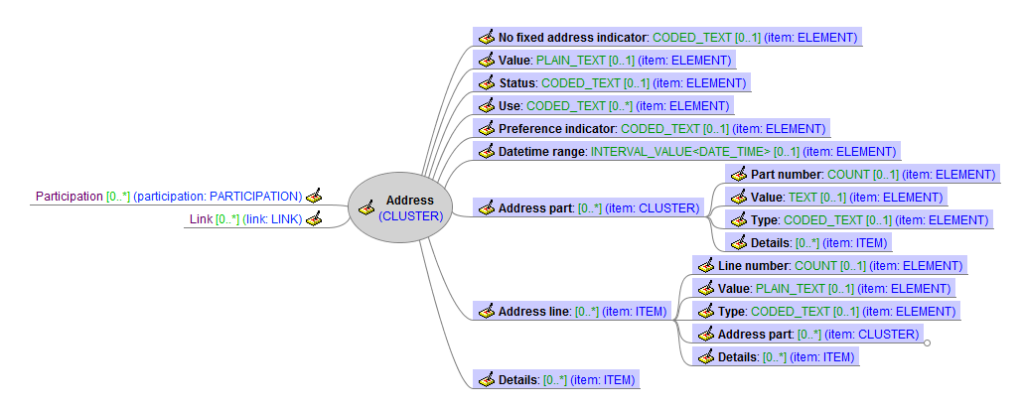
Address
CLUSTER
constrains

Slide 22
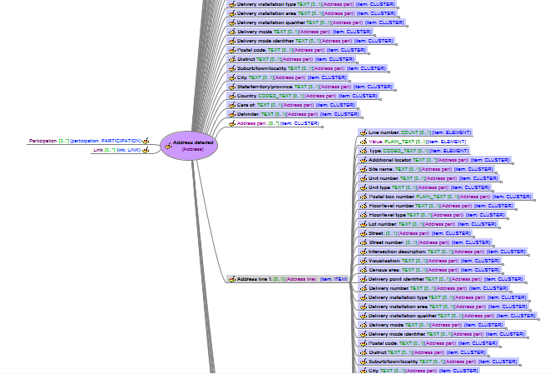
Address Detailed
CLUSTER
constrains
Address
constrains

Slide 23
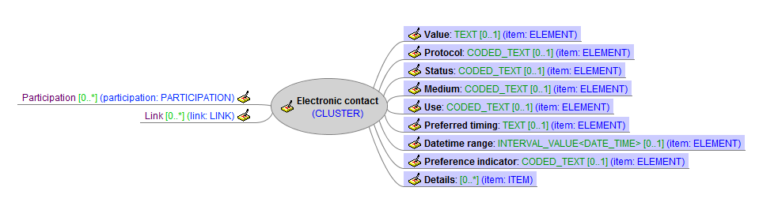
Electronic Contact
CLUSTER
constrains

Slide 24

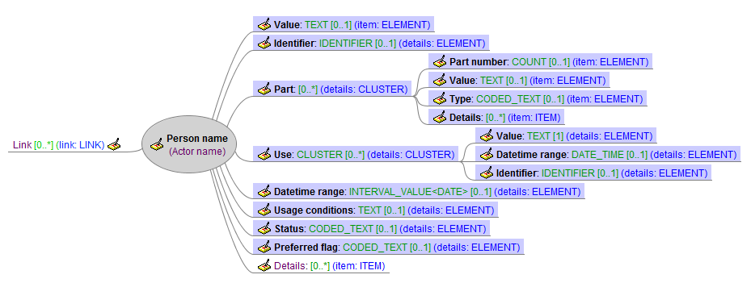
Party Name
CLUSTER
constrains
constrains
Actor Name
constrains

Slide 25
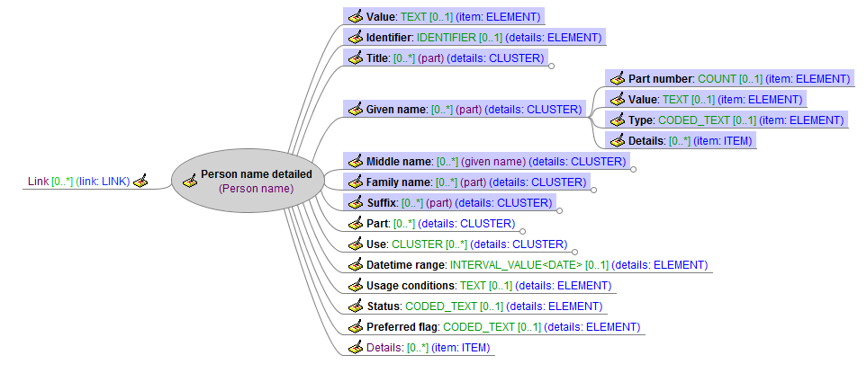
Party Name
Person Name
constrains

Slide 26
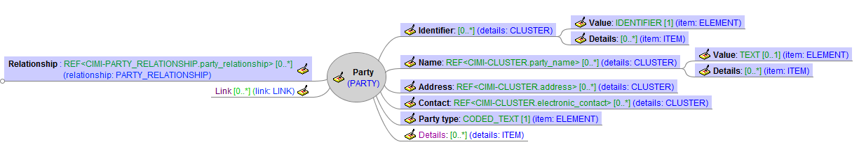
Party
PARTY
constrains

Slide 27
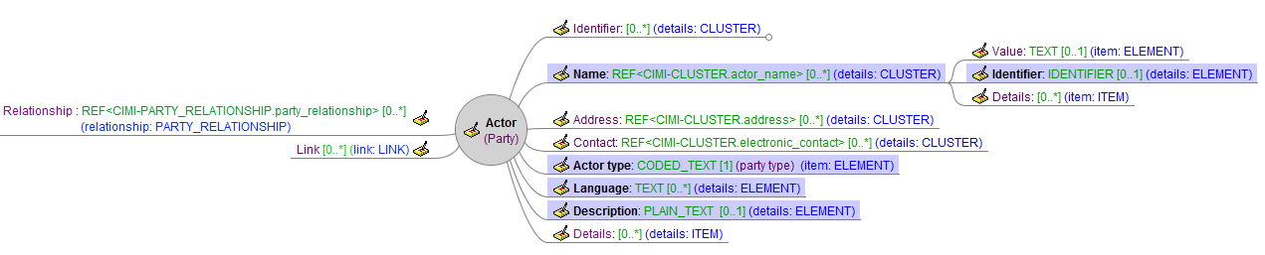
Actor
PARTY: ACTOR
constrains
Party
constrains

Slide 28
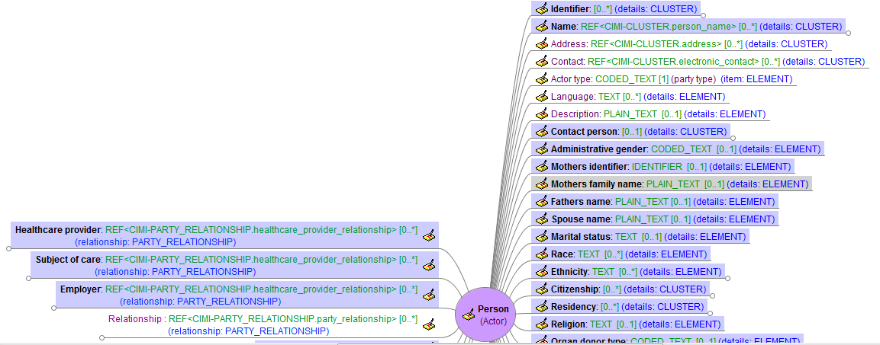
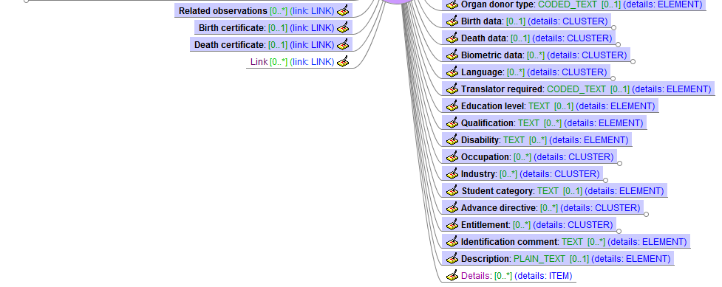
Person
Party
constrains
Actor
constrains

Slide 29
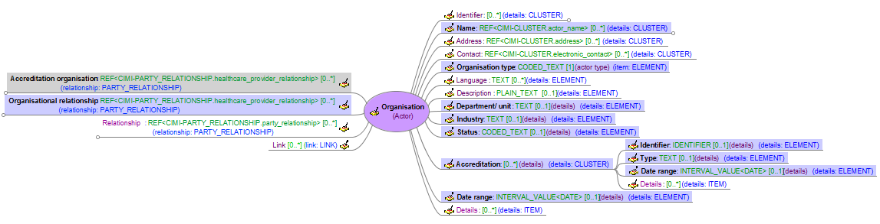
Organisation
Party
constrains
Actor
constrains

Slide 30
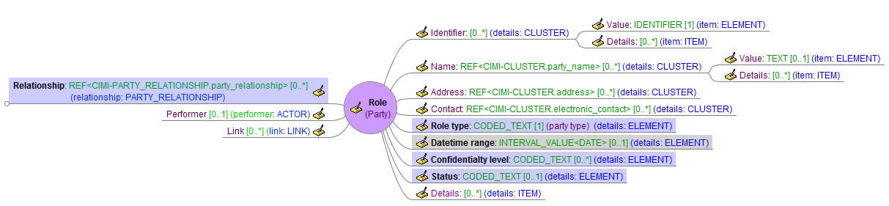
Role
PARTY: ROLE
constrains
Party
constrains

Slide 31
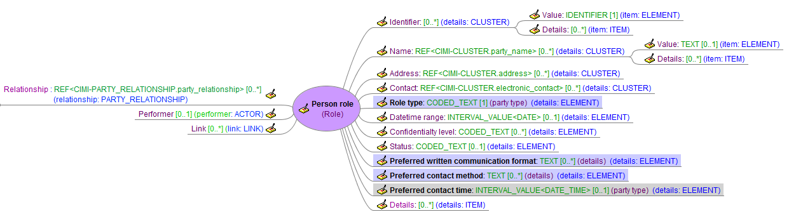
Person Role
Party
constrains
Role
constrains

Slide 32
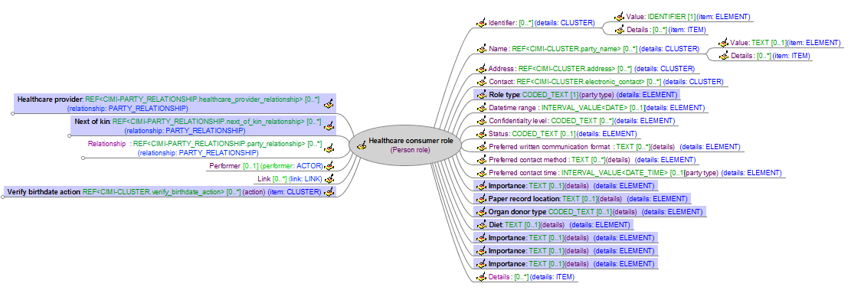
Healthcare Consumer
Party
constrains
Role
constrains
Person Role
constrains

Slide 33
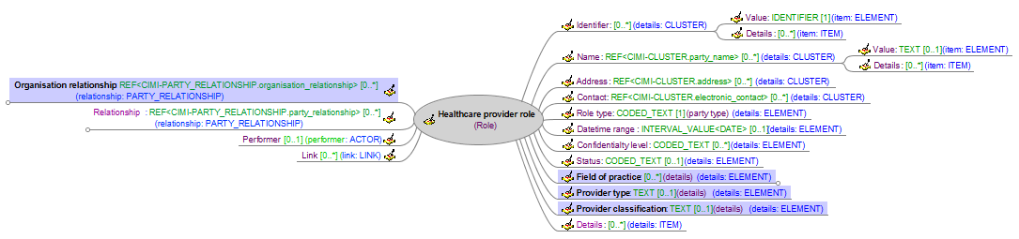
Healthcare Provider
Party
constrains
Role
constrains

Slide 34
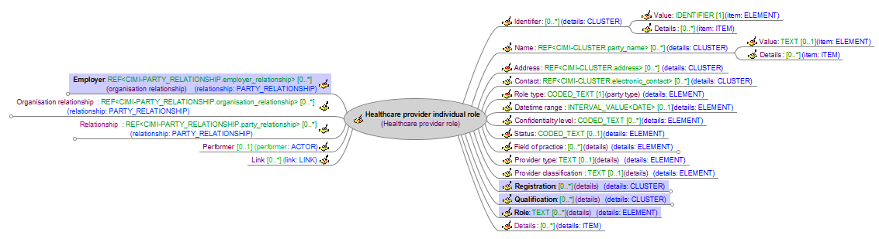
Healthcare Provider Individual
Party
constrains
Role
constrains
Healthcare Provider
constrains

Slide 35
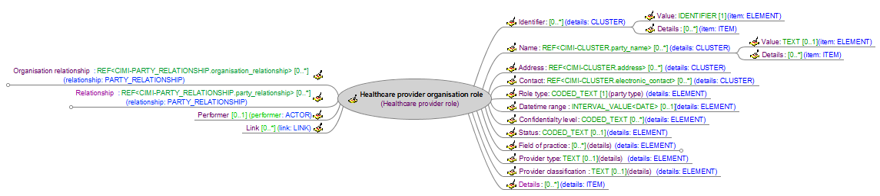
Healthcare Provider Organisation
Party
constrains
Role
constrains
Healthcare Provider
constrains

Slide 36
Future work

Slide 37
Future Work
Foundations
Reference model
Documentation and implementation
Archetype object model
Extensions to support terminology
Modelling patterns
Documentation and terminology bindings
Add new patterns to support new models
Style guides
Complete content
Models
Laboratory Results models
Add instances, specialisations and complete terminology bindings
Immunization models
Temperature and other priorities
Implementation
Generate ADL 1.5 for all modelling patterns and models
Build modelling foundations in tooling infrastructure
Create associated tooling, including instance generation and visualisations
Create transformations to priority implementation formats
Governance
Establish modelling development, review and publication processes and procedures

Slide 38
Online References
CIMI Web Page
http://informatics.mayo.edu/CIMI
Google doc repository
http://content.clinicalmodels.org
Google groups email list (cimi-modelling-taskforce)
http://groups.google.com/group/cimi-modelling-taskforce?hl=en-GB
Issue tracking (github)
https://github.com/clinicalmodels/cimi/

Slide 39
questions

